Slide 1



Customer Data Platform
Data Masking & Tagging
02/01/2022

Slide 2
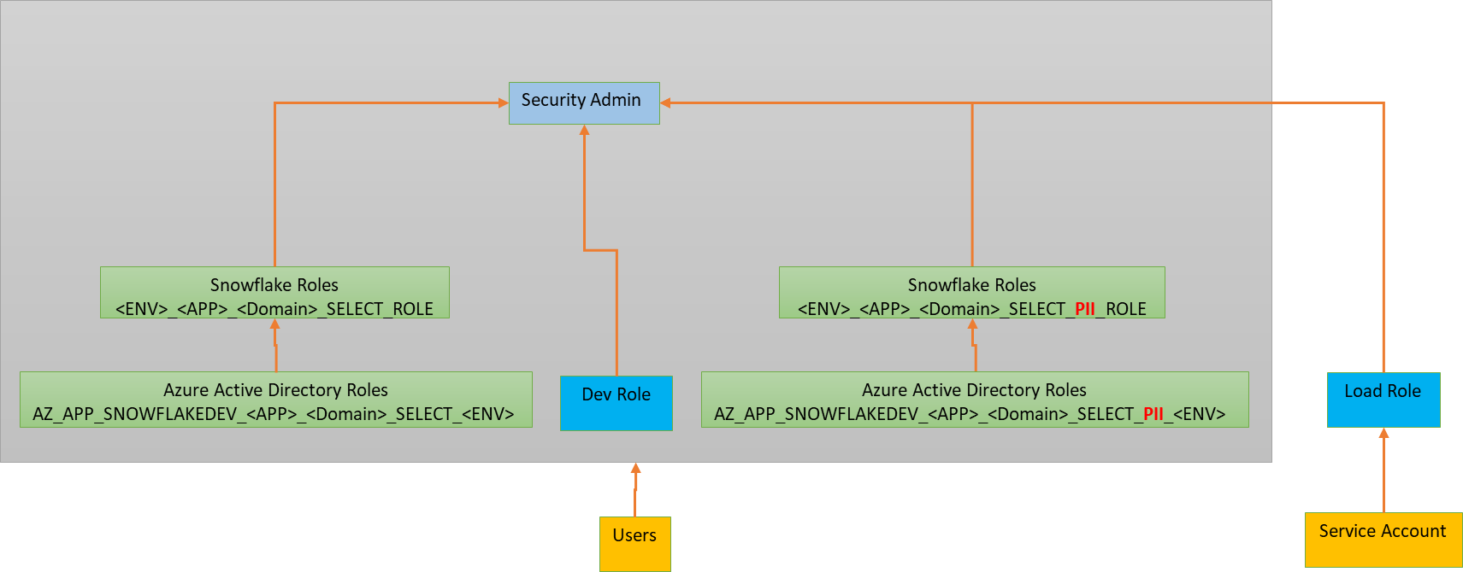
CDP Current Roles & Hierarchy
Any Role with <PII> can see the sensitive data
Load/Service/EDC Role can see the sensitive data

Slide 3
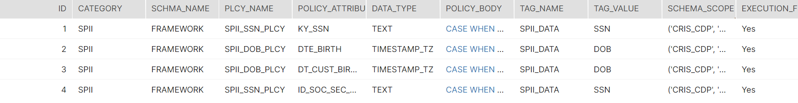
Potential Design thought (For Release 1)
Have a Framework table (Policy_reference)
Category specifies if it is SPII or PII
Use one schema (Framework) in this case for entire Application
Policy_Name mentions the Masking Policy to be created
Policy_Attribute mentions the Column that has PII and to be masked
Policy_Body will be potential Masking logic
Tag_Value can be the Value of the PII Tag that can be associated for Auditing
When a new attribute is identified that need to be masked, just make an entry to this table. For e.g., in case if EIN to be masked tomorrow, have an entry as below

Slide 4
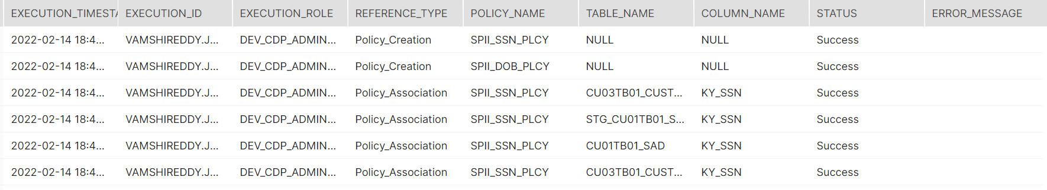
Potential Design thought (For Release 1)
Automated Execution of Masking
Stored Procedure framework.Create_policies() – This loops through each entry in the framework table (previous slide) and creates masking policy.
Stored Procedure framework.Associate_policy() – This associates the corresponding policies to the respective element (column) in entire Database tables. This also assigns the tag value to the respective elements in all tables.
Need to finalize on the usage of MD5 Hashing –
SSNs are updated to String and will be masked as ****
Date Birth fields will be masked as 12/31/9999
Audit/Log table to capture Policies created and associated –

